Slide 1





Change in Mental Status
Long Term Care
Ruth Kandel, MD
Director, Infection Control
Hebrew SeniorLife
Assistant Professor
Harvard Medical School
Boston, MA
Consultant to Massachusetts Partnership Collaborative:
Improving Antibiotic Stewardship for UTI

Slide 2

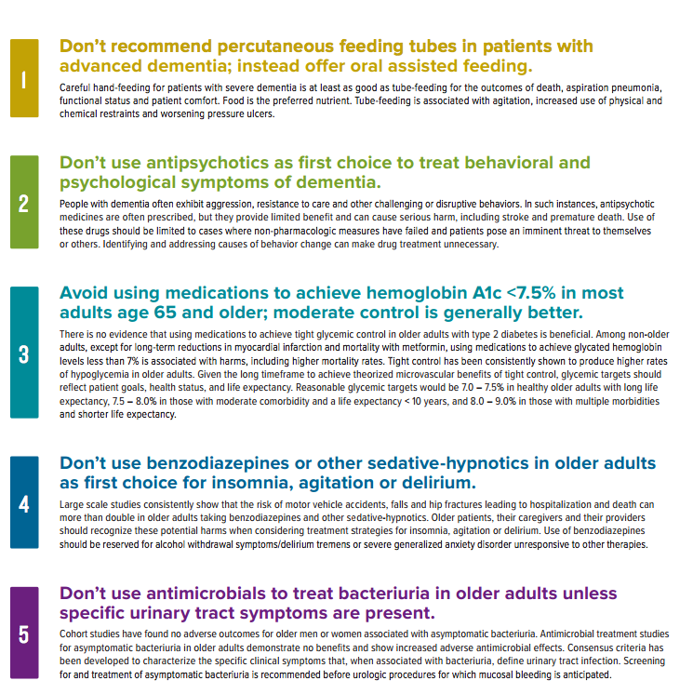

Slide 3
Revised McGeer
Resident Without Indwelling Catheter
(A) Clinical (At least one of the following must be met) | (B) Lab (At least one of the following must be met)
Either of the following: ☐ Acute dysuria or ☐ Acute pain, swelling or tenderness of testes, epididymis or prostate | 1. VOIDED SPECIMEN: POSITIVE URINE CULTURE (> 10⁵ CFU/ML) NO MORE THAN 2 ORGANISMS
If either FEVER or LEUKOCYTOSIS present need to include ONE or more of the following: □ Acute costovertebral angle pain or tenderness □ Suprapubic pain □ Gross hematuria □ New or marked increase in incontinence □ New or marked increase in urgency □ New or marked increase frequency | 2. STRAIGHT CATH SPECIMEN: POSITIVE URINE CULTURE (> 10² CFU/ML) ANY NUMBER OF ORGANISMS
3. If neither FEVER or LEUKOCYTOSIS present INCLUDE TWO or more of the ABOVE. | Infect Control Hosp Epidemiol 2012;33:965-977

Slide 4
Revised McGeer
Resident With Indwelling Catheter
(A) CLINICAL (At least one of the following present with no alternate explanation) | (B)LAB (Must be met)
☐ Fever | ☐ Positive urine culture (> 10⁵ CFU/ML) OF ANY ORGANISM(S)
☐ Rigors
☐ New onset hypotension
☐ Either acute change in mental status or acute functional decline, with no alternate diagnosis AND leukocytosis
☐ New onset costovertebral angle pain or tenderness
☐ New onset suprapubic pain
☐ Acute pain, swelling or tenderness of the testes, epididymis or prostate
☐ Purulent drainage from around the catheter | Infect Control Hosp Epidemiol 2012;33:965-977

Slide 5
Loeb Minimal Criteria 2001
Initiating Antibiotics
No Indwelling Catheter
Chronic Indwelling Catheter
Acute dysuria Or
Fever* + new or worsening (must have at least one of following)
  Urgency
  Frequency
  Suprapubic pain
  Gross hematuria
  Costovertebral angle tenderness
  Urinary incontinence
Must have at least one of the following
Fever*
  New costovertebral angle tenderness
  Rigors (shaking chills)
  New onset delirium
  *Fever > 100° or 2.4° F above baseline
        ICHE 2001;22:120-124

Slide 6
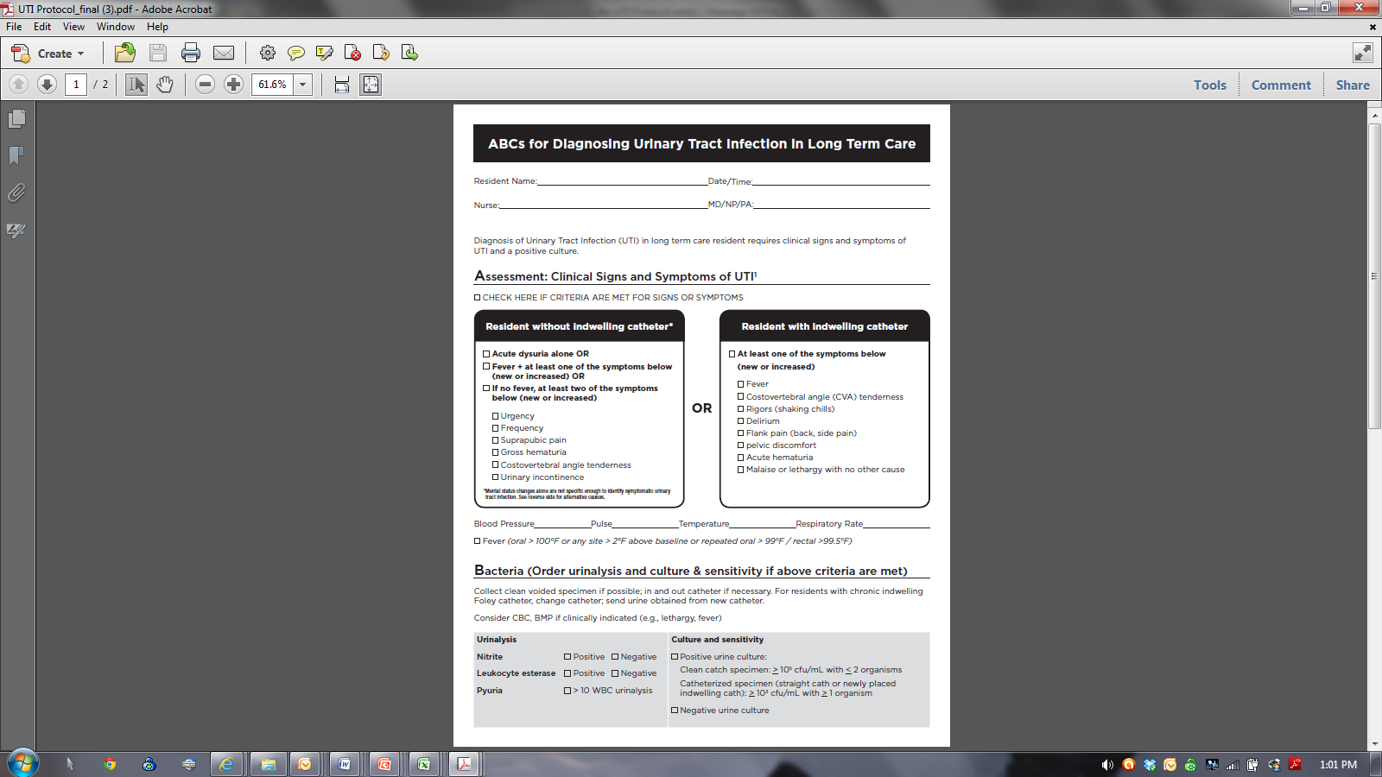
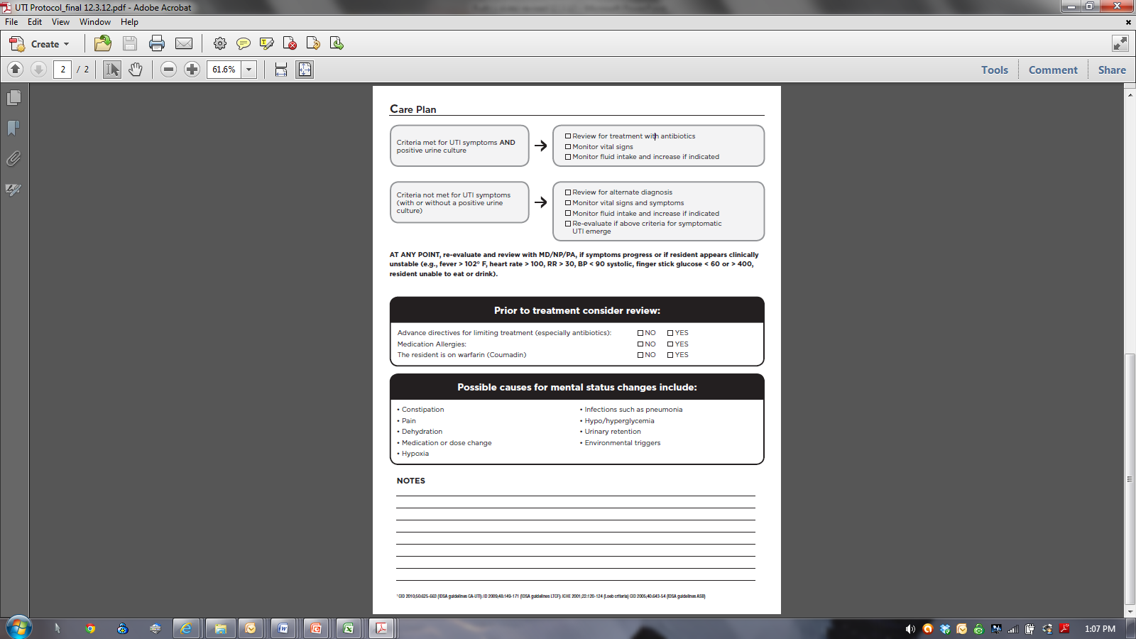
UTI Protocol: ABCs

Slide 7
Asymptomatic Bacteriuria (ASB)
Laboratory diagnosis
Positive urine culture
  Colony count significant (> 10⁵ cfu/mL)
Absence of symptoms
                Clinical Infectious Disease 2010;50:625-663

Slide 8
Prevalence of ASB
  POPULATION Prevalence %
Older long-term care residents
  Women 25-50
  Men 15-40
Patients with an indwelling catheter
  Short-term 9-23
  Long-term 100
                CID2005;40:643-654

Slide 9
Change in Mental Status ≠ Symptomatic Urinary Tract Infection
LTCF residents with cognitive impairment are more likely to have ASB (no symptoms, positive urine culture).
LTCF residents with cognitive impairment are more vulnerable to changes in mental status with any new problem.
THEREFORE, resident with cognitive impairment and change in mental status
  MORE LIKELY to have a positive urine culture,
  Independent of whether infection is the cause of clinical decline,
  OR if infection is present, whether urinary tract is the source.
        JAGS 2009 57:1113-1114

Slide 10
Change in Mental Status in Dementia
Acute change in cognition
  Confusion
Acute change in behavior
  Aggression or agitation (verbal or physical)
  Resistance to care
  Hallucinations
  Delusions
  Lethargy
Acute change in function (activities of daily living)

Slide 11
Acute Change in Mental Status:
Confusion
DELIRIUM: Acute change in mental status from baseline with acute onset
Fluctuating course
Inattention AND
Disorganized thinking OR
Altered level of consciousness.
McGeer Revised 2012

Slide 12
Confusion Assessment Method Criteria
Acute change in resident’s mental status from baseline
Fluctuating Behavior
  Coming and going or changing in severity during the assessment.
Inattention
  Difficulty focusing attention (e.g., unable to keep track of discussion or easily distracted).
Disorganized thinking
  Thinking is incoherent (e.g., rambling conversation, unclear flow of ideas, unpredictable switches in subject).
Altered level of consciousness
  Level of consciousness is described as different from baseline (e.g., hyperalert, sleepy, drowsy, difficult to arouse, nonresponsive).
    McGeer Revised 2012

Slide 13
Course of Subsyndromal Delirium
Long Term Care Residents
There may be a continuum between no delirium and full delirium characterized by
  Increasing number of symptoms
  Increasing duration of episodes
  Am J Geri Psych March 2013

Slide 14
Acute Change in Mental Status:
Behavioral Problems
Agitation
Anxiety
Resistance to care
Disinhibited behaviors
Depression
Hallucinations
Delusions

Slide 15
Acute Change in Mental Status:
Behavioral Problems
Alzheimer's disease
  Apathy, agitation, anxiety,
  Depression, irritability
Dementia with Lewy bodies
  Visual hallucinations, delusions, depression, REM sleep behavior disorder
Vascular dementia
  Apathy, depression, delusions
Dementia associated with Parkinson's disease
  Visual hallucinations, delusions, depression, REM sleep behavior disorder
Frontotemporal dementia
  Apathy, disinhibition, elation, repetitive behaviors, appetite or eating changes
Progressive supranuclear palsy
  Apathy, disinhibition
Corticobasal degeneration
  Depression
Lancet Neurology November 2005

Slide 16
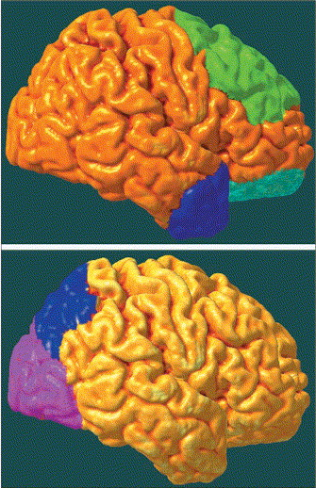
The influence of regional pathologies on neuropsychiatric symptom formation
Top: apathy and behavioural disinhibition in Alzheimer's disease are associated with reduced frontal lobe activity.
Bottom: visual hallucinations and misidentification syndromes in DLB are by contrast, probably generated by reductions in posterior visual cortical activity.
Ian McKeith , Jeffrey Cummings
Behavioural changes and psychological symptoms in dementia disorders
The Lancet Neurology Volume 4, Issue 11 2005 735 - 742

Slide 17
Dementia with Lewy Bodies
CORE FEATURES
Fluctuating cognition with pronounced variations in attention and alertness
Recurrent visual hallucinations that are typically well formed and detailed
Spontaneous features of parkinsonism
SUGGESTIVE FEATURE
REM sleep behavior disorder
McKeith IG, Dickson DW, Lowe J, et al. Diagnosis and management of dementia with Lewy bodies: Third report of the DLB consortium. Neurology 2005;65:1863-1872

Slide 18
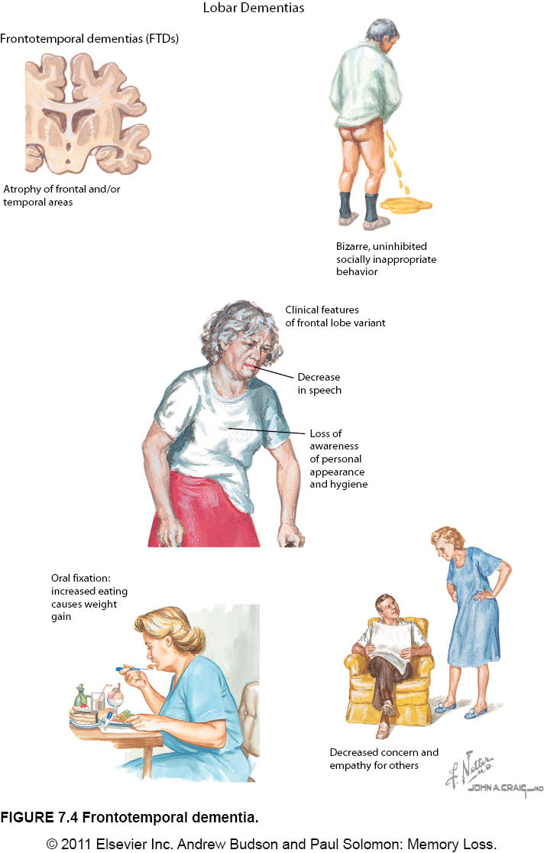
Frontotemporal Dementia

Slide 19
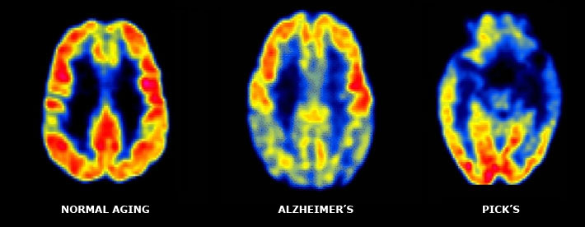
FDG PET Imaging

Slide 20
Vascular Dementia Subtypes
Subcortical ischemic COMMON FORM
  Caused by lacunes and white matter ischemia
  Often involves specific prefrontal subcortical circuits
  Clinically
    Executive dysfunction
    Memory deficits less severe than in AD
    Behavioral changes include depression, personality changes, labile emotionality
    Onset slow and subtle
    May see gait disorder, urinary urgency, psychomotor slowing
                Stroke 2004;35:1010-1017

Slide 21
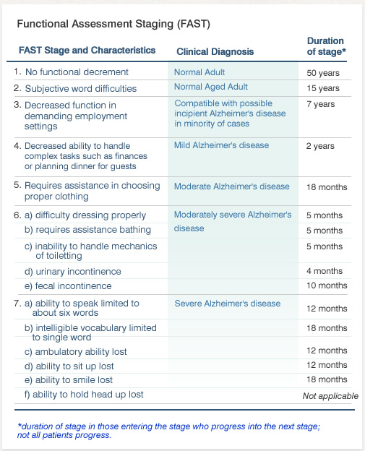
Functional Changes

Slide 22
Don’t Forget…
…we all have good and bad days.

Slide 23
Change in Mental Status: Delirium(s)
D Drugs Dementia Type Discomfort Depression | BEERS Criteria (e.g., anticholinergic, benzodiazepines, hypnotics) OR dose change For example, dementia Lewy bodies: Fluctuations in alertness and attention Pain
E Eyes, ears Environment | Sensory deprivation Vulnerability to environment
L Low oxygen states | Myocardial infarction, stroke, pulmonary embolus
I Infection | Pneumonia, sepsis, symptomatic UTI
R Retention RBCs (red blood cells) | Urinary retention, constipation Anemia
I Ictal states | Seizure disorder
U Underhydration/nutrition | Dehydration
M Metabolic Causes | Low or high blood sugar, sodium abnormalities
S Subdural hematoma | Head trauma Adapted from Saint Louis University Geriatric Evaluation Mnemonics Screening Tools

Slide 24
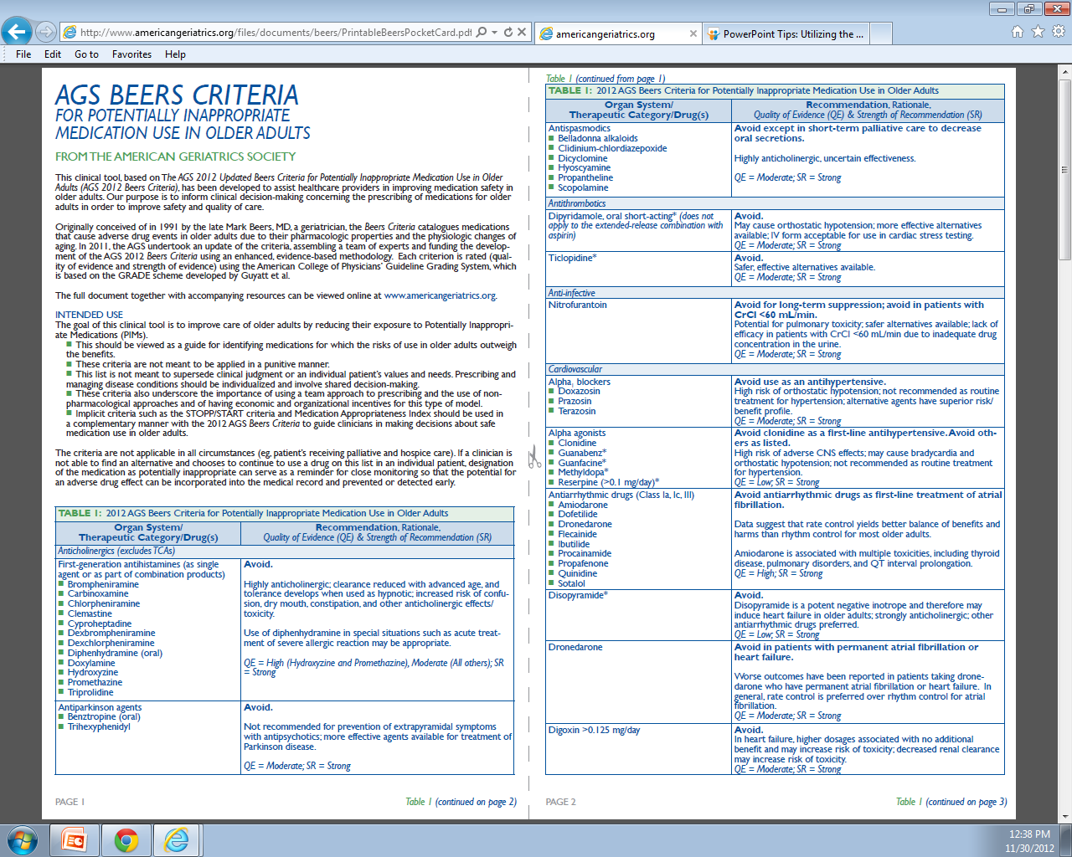
Beers Criteria 2012

Slide 25
ABCs of Challenging Behavior
Behavior
(B)
Consequences
(C)
Antecedents
(A)

Slide 26
ABCs of Challenging Behavior
Activators (antecedent)
  What are the triggers for the behavior?
Behavior
  What is the nature of the behavior?
Consequences
  What impact does the behavior have on the patient and others?

Slide 27
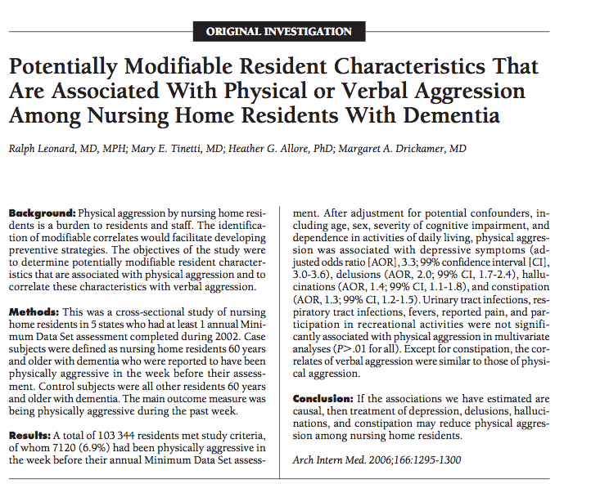

Slide 28
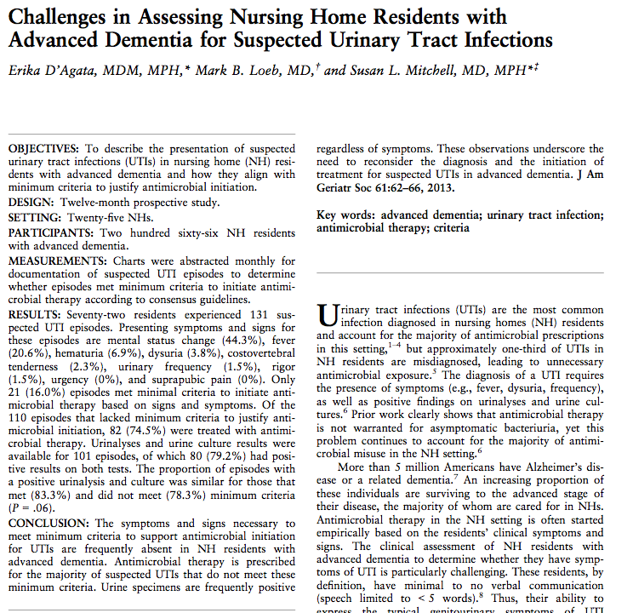

Slide 29
When Antibiotics are Not Prescribed
(Monitoring Protocol)
Monitor vital signs for several days
Monitor for progression of symptoms or change in clinical status
Encourage fluid intake
Consider alternate diagnosis for nonspecific symptoms
If symptoms resolve, no further intervention required
                Annals of LTC April 2012;20:23-29

Slide 30
Sample Checklist
Type of Dementia | Urinary Retention, Constipation
Drugs (new or dose change) | Dehydration
Discomfort (e.g., pain, insomnia) | Head Trauma
Depression | Metabolic abnormalities (e.g., hypoglycemia, hyponatremia)
Hearing Loss/ Vision Impairment | Medical Problems: Stroke, MI, PE Postictal (Seizure Disorder) Anemia
Environment (e.g., overstimulation) | Infection (e.g., pneumonia, sepsis, symptomatic UTI)

Slide 31
Consider Urgent Evaluation
Significantly abnormal vital signs
  Systolic BP <90, heart rate <50 or > 120, respirations >30, temperature <96 or >101
Signs of distress
  New onset respiratory distress with increasing hypoxia or dyspnea
Signs of serious underlying condition
  For example, symptoms of stroke
Escalating aggressive or violent behavior
Resident is a threat to self or others
            AMDA Clinical Practice Guidelines Delirium LTC Setting 2008

Slide 32
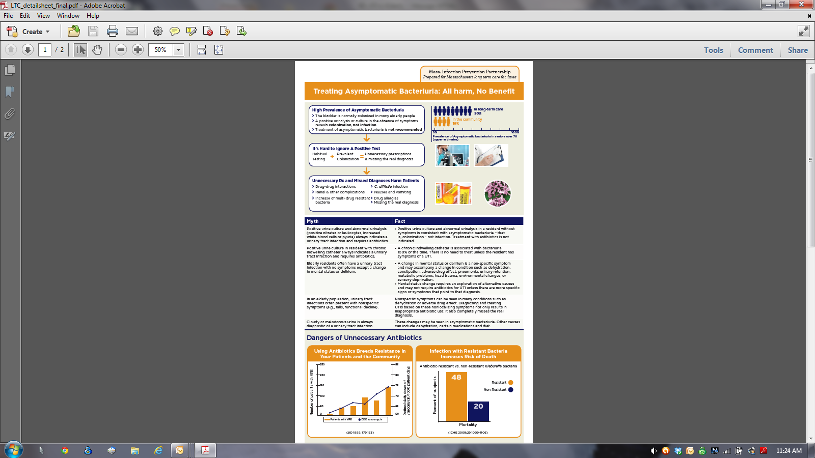
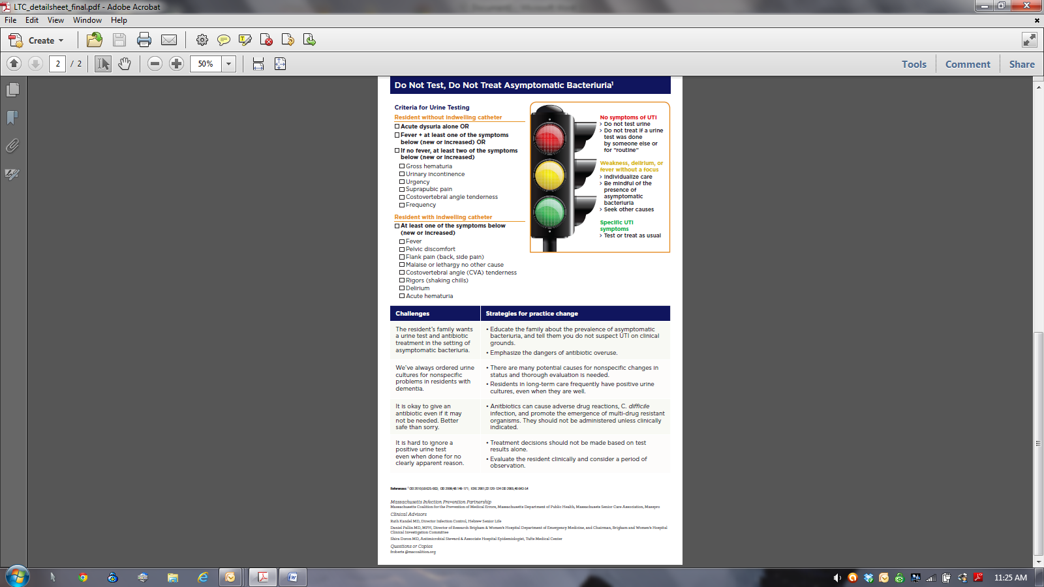
Clinician Education Sheet

Slide 33
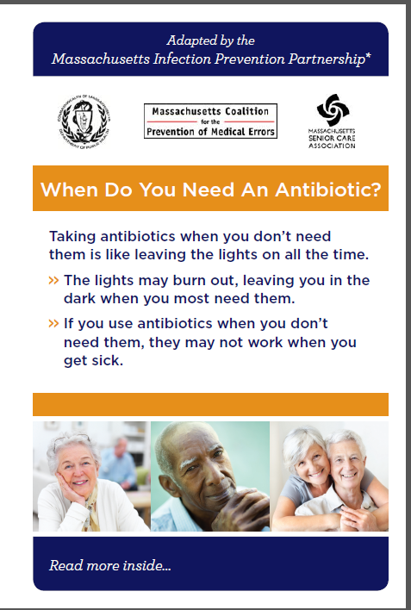
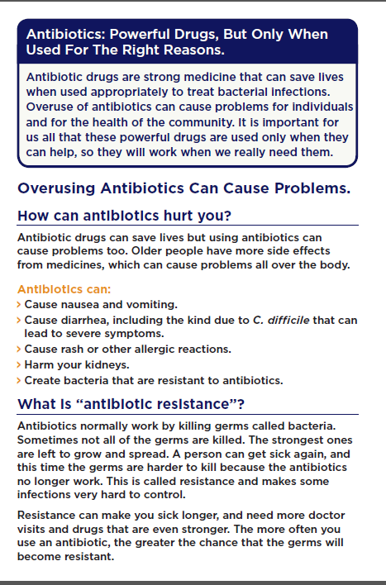
Resident/Family Brochure

